Slide 1

OPEN SCIENCE · OPENCITATIONS · DATA MANAGEMENT PLAN
OpenCitations Data
Management Plan Project
Yifan Wu
Open Science · a.y. 2025/2026
Notes:
开场约 40 秒。介绍项目主题：为六个 OpenCitations research outputs 制定数据管理计划，并把 Argos 导出的结构化数据转化为更适合阅读的网页。说明这套 slides 与现有网页配套使用。
Visual source: project website asset assets/ocdm-hero.png

Slide 2
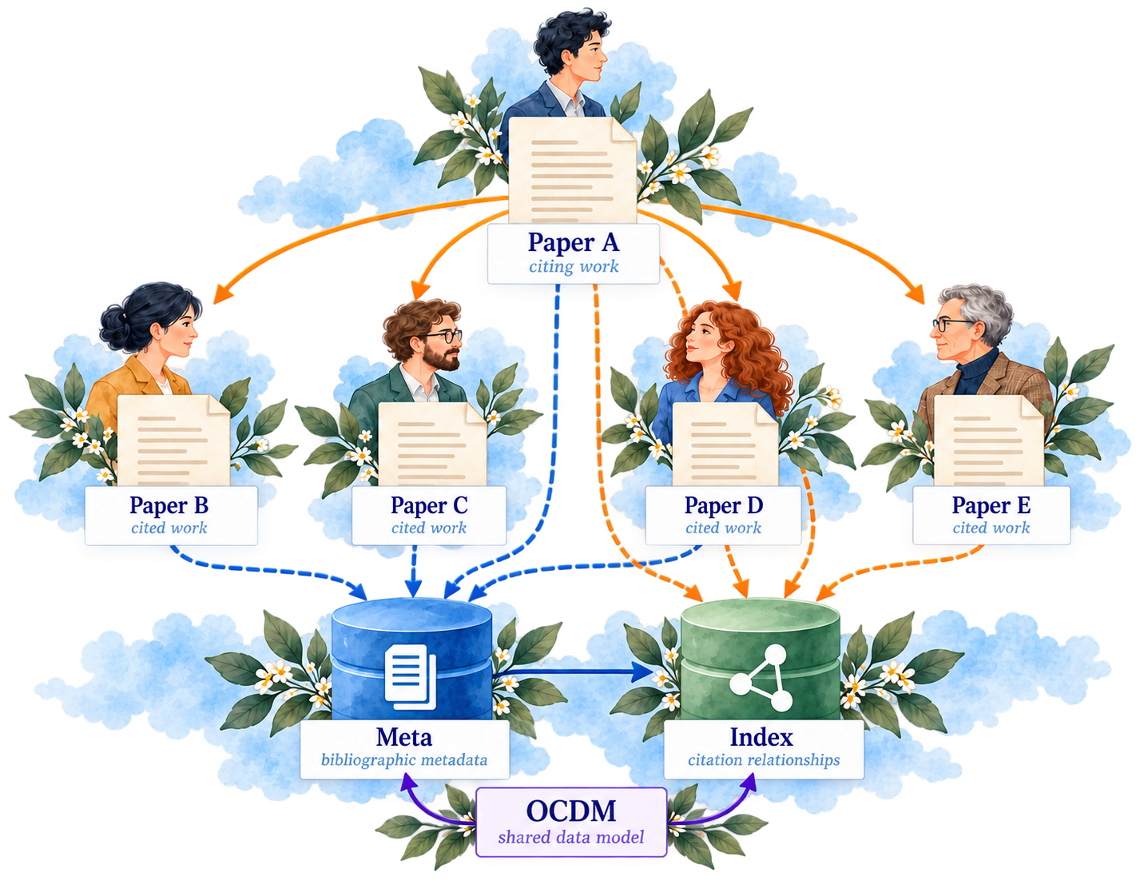
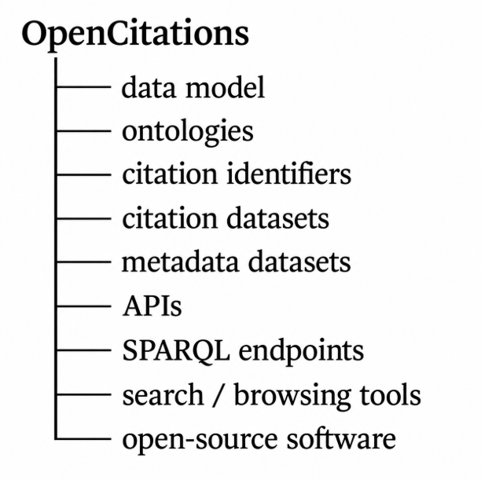
OPEN SCIENCE · OPENCITATIONS · DATA MANAGEMENT PLAN
OpenCitations
Open infrastructure for bibliographic metadata and citation data.
OpenCitations collects, organizes, and publishes scholarly citation data as reusable open data.
It represents citations as explicit, queryable relationships between scholarly works
Meta manages the bibliographic entities involved in citations and their metadata(titles, authors, publication venues, identifiers, and provenance).
Index manages the citation relationships between those entities.
OCDM provides the shared data model that defines how scholarly entities, identifiers, citations, and provenance are represented consistently.
Notes:
约 70 秒。解释 citation data 如何连接论文。OpenCitations 将 bibliographic metadata 和 citation relationships 作为开放基础设施提供。图中 Meta 管理实体和元数据，Index 管理引文关系，OCDM 则定义共同的表示方式。
Visual source: project website asset assets/section2-citation-ecosystem.png

Slide 3
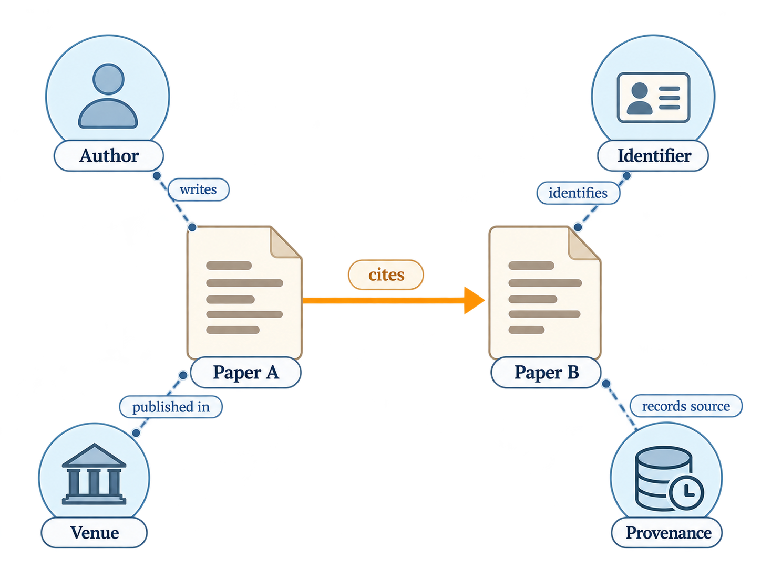
OPEN SCIENCE · OPENCITATIONS · DATA MANAGEMENT PLAN
OCDM
A shared semantic model for scholarly entities, citations, identifiers, and provenance.
The OpenCitations Data Model (OCDM) defines how scholarly information is represented and connected.
ID | Description
P1 | A classification of the type of citation (e.g. self-citation)
P2 | The bibliographic metadata of the citing and cited bibliographic entities (e.g. type of published entity, identifiers, authors, contributors, publication date, publication venues, publication formats)
P3 | The bibliographic reference, typically found within the reference list of the citing bibliographic entity, that references a cited bibliographic entity
P4 | The separate identifiers of all the in-text reference pointers included in the text of the citing entity, that denote bibliographic references within the reference list
P5 | The co-occurrence of in-text reference pointers within each in-text reference pointer lists (e.g. “[3,5,12]”)
P6 | The identifiers of structural elements (e.g. XPath of sentences, paragraphs, captions) that specify where, in the full text, an in-text reference pointer appears
P7 | The function or purpose of the citation (e.g. to cite as background, extend, or agree with the cited entity) to which each in-text reference pointer relates
P8 | Provenance information of the citation extraction process (e.g. responsible agents, data sources, extraction dates)
It provides a common structure for publications, authors, identifiers, citation relationships, publication venues, and provenance.
OCDM reuses established Semantic Web ontologies to express data from different sources in a consistent and interoperable form.
It represents scholarly entities together with their relationships, such as an author writing a paper, one paper citing another, or an identifier referring to a scholarly resource.
Table. Representational requirements of the OpenCitations Data Model
Notes:
约 70 秒。OCDM 不是一个数据库，而是一套用于描述 scholarly bibliographic information 和 citations 的数据模型。用图中的 Paper A 与 Paper B 说明关系如何被明确表达，同时将作者、venue、identifier 与 provenance 连接起来。
Visual source: project website asset assets/section2-ocdm-relations.png

Slide 4
OPEN SCIENCE · OPENCITATIONS · DATA MANAGEMENT PLAN
OCDM layers
Data Model: OCDM
Defines the shared representation of scholarly entities, citations, identifiers, and provenance.
Collections: Meta & Index
Meta stores bibliographic metadata and identifiers.
Index stores citation relationships between scholarly entities.
Software: oc_meta · oc-index · oc_ocdm
oc_meta curates bibliographic metadata and generates OCDM-compliant RDF.
oc-index constructs citation data and maps citation endpoints to OpenCitations identifiers.
oc_ocdm provides a Python interface for creating and manipulating OCDM-compliant RDF.
Quality Control: Validator & Monitor
The Validator checks data before ingestion.
The Monitor checks published collections for known data-quality issues.
Together, these layers connect the data model, scholarly collections, software workflows, and quality-control processes of OpenCitations.
Open Science Infrastucture
OpenCitations
01
Data Model
OCDM
shared representation rules
02
Collections
Meta
Index
bibliographic metadata
citation relationships
03
Software
oc_meta
oc-index
oc_ocdm
metadata curation
citation construction
OCDM data interface
SUPPORTING QUALITY CONTROL
Validator pre-ingestion Monitor post-ingestion

Slide 5
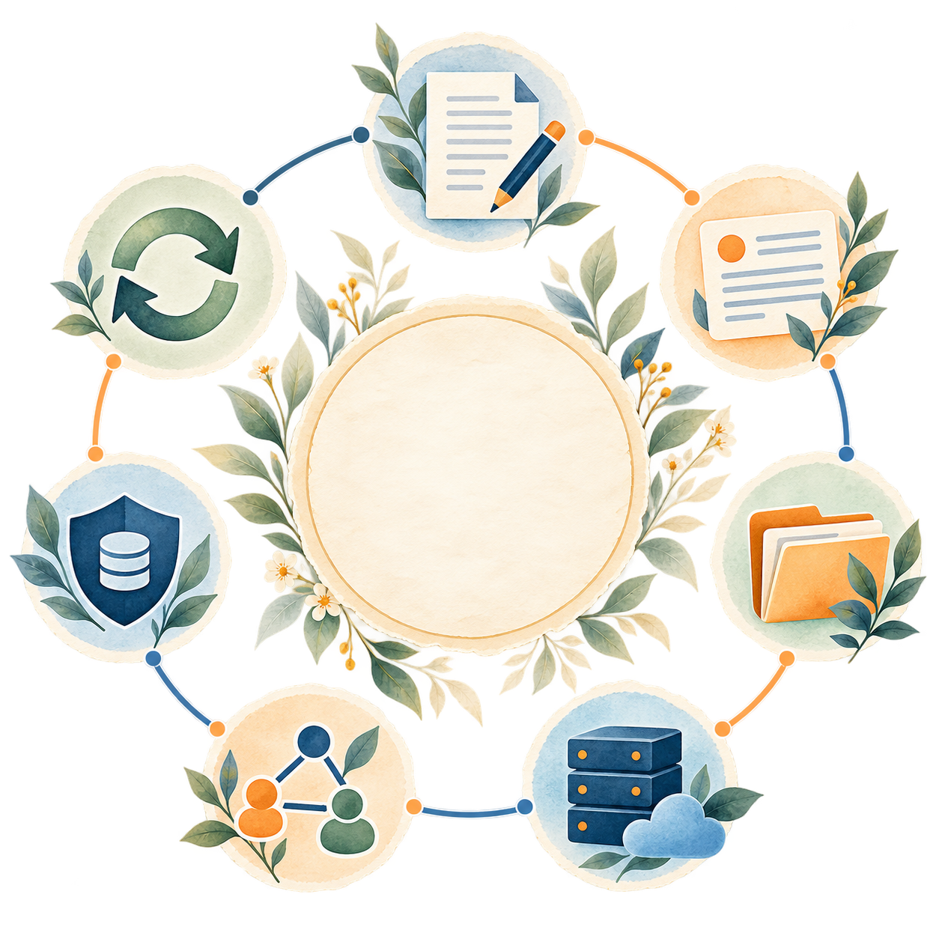
OPEN SCIENCE · OPENCITATIONS · DATA MANAGEMENT PLAN
Argos, DMP, and Description
Create
DMP is a structured way to plan and document the management of research outputs
A Data Management Plan (DMP) records how research outputs are managed throughout their lifecycle.
It covers how resources are created, described, organised, stored, shared, preserved and reused, together with responsibilities, access conditions, licensing, quality and security.
Argos provides the structured environment for creating the DMP.
It organises management information into sections and questions and keeps project-level information together within one plan.
Each research output has its own descriptions.
A description applies the DMP framework to one specific resource and records its characteristics, access, preservation, FAIR practices, quality and responsibilities.
Describe
Reuse
DMP
Organise
Preserve
DMP - The overall management plan
Argos - The platform that structures and records the plan
Description - The management record for one research output
Store
Share
A DMP connects management decisions across the entire lifecycle of a research output
Notes:
约 75 秒。先定义 DMP：它覆盖 research output 从创建到 reuse 的整个生命周期。再说明 Argos 是创建和组织计划的平台。最后明确层级关系：Plan 管项目，Description 管一个具体 research output。
Visual source: project website asset assets/section3-dmp-lifecycle.png

Slide 6

DESCRIPTIONS
03 ETHICS AND LEGAL ASPECTS
01 YOUR RESEARCH OUTPUT
3.1. Personal data
3.2. Legal aspects
3.3. Other ethical aspects
1.1. Contact details and responsibilities
1.2. Resources for data management
1.3. Identifying the research output
04 MAKING RESEARCH FAIR
4.1. Long-term preservation
4.2. Findability
4.3. Accessibility
4.4. Interoperability
4.5. Reusability
02 SUMMARY
2.1. Identification of the dataset (Identification of software)
2.2. Dataset characteristics (Software characteristics)
05 QUALITY AND SECURITY
5.1. Quality of the research output
5.2. Security measures
Notes:
约 90 秒。完整介绍 Description 的五组要求：research output 的身份与责任、summary、伦理与法律、FAIR 与长期保存、quality 与 security。六份 Description 使用同一结构，但答案来自各资源自身的证据。
Visual source: project website asset assets/section3-description-book.png

Slide 7
OPEN SCIENCE · OPENCITATIONS · DATA MANAGEMENT PLAN
Project workflow
01
02
03
Read the papers
Create the DMP in Argos
Create six Descriptions
Understand OCDM and the OpenCitations ecosystem
I started with the six papers provided for the course. They helped me understand OCDM, OpenCitations Meta, Index, and the related software before building the DMP.
Set up the project in Argos
I created the OpenCitations Data Management Plan in Argos and added the main project information, contacts, contributors, and overall scope.
Describe the six research outputs
Inside the DMP, I created one Description for each research output and filled in information about
Your Research Output · Summary · Ethics & Legal · Making Research FAIR · Quality & Security
OUTPUT · Research Notes
OUTPUT · DMP
OUTPUT · Six Descriptions
04
05
06
Export the JSON
Build the Python translator
HTML generation
Get the machine-readable version
After completing the DMP, I exported it from Argos as JSON and checked how the Plan and the six research outputs were represented in the file.
Turn the JSON into something easier to read
I wrote a Python script to load the JSON, go through its structure, extract the information I needed, and prepare it for HTML output.
Create the human-readable result
Finally, I ran the Python script and generated a human-readable HTML page that presents the DMP information in a clearer and more browsable format.
OUTPUT · JSON
OUTPUT · Translator.py
OUTPUT · HTML
Notes:
约 90 秒。按照六步工作流介绍项目：先为六个资源建立证据基础，再在 Argos 中完成一个 Plan 和六份 Descriptions；随后导出并检查 RDA JSON，使用 Python 规范化字段，最后生成并验证 HTML 界面。

Slide 8
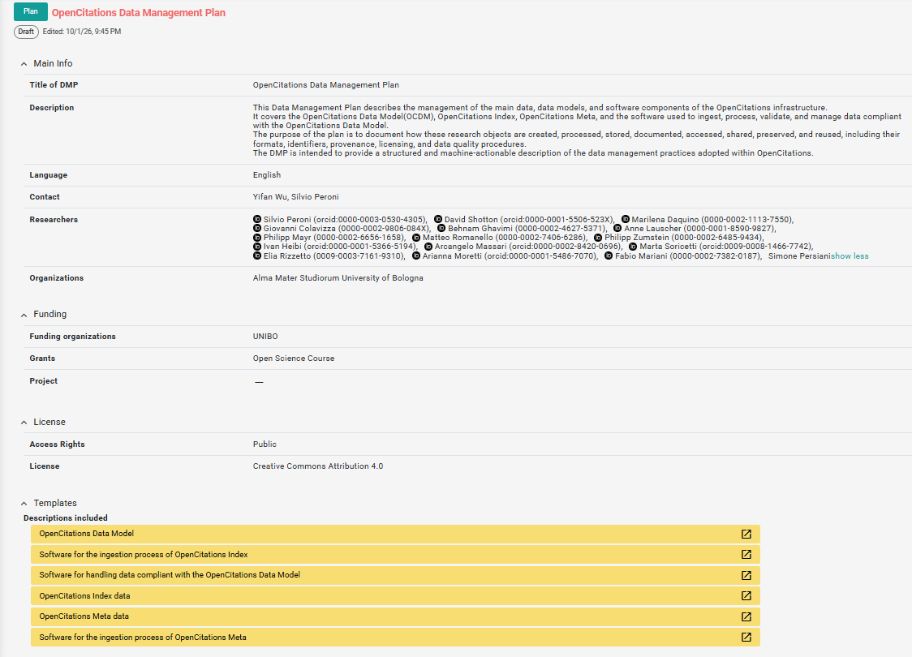
OPEN SCIENCE · OPENCITATIONS · DATA MANAGEMENT PLAN
OCDM DMP and Descriptions
The made OpenCitations Data Management Plan records how six research outputs are identified, documented, accessed, preserved, and maintained.
At the Plan level, Argos records the overall project context, including the title, organisation, contacts, contributors, access conditions, and general project information.
The Plan contains six research outputs: OCDM, OpenCitations Meta, OpenCitations Index, oc_meta, oc-index, and oc_ocdm.
Each research output has its own Description.
The Description applies the same management framework to one specific resource and records folowing 5 parts:
Your Research Output · Summary · Ethics & Legal · Making Research FAIR · Quality & Security
https://argos.openaire.eu/plans/overview/84eff3c4-1d9b-4c02-b776-7eecaab6ecbe
Notes:
Section 05 reserved base slide. Add content directly on this layout. The landscape footer comes from the reusable OCDM slide master.

Slide 9
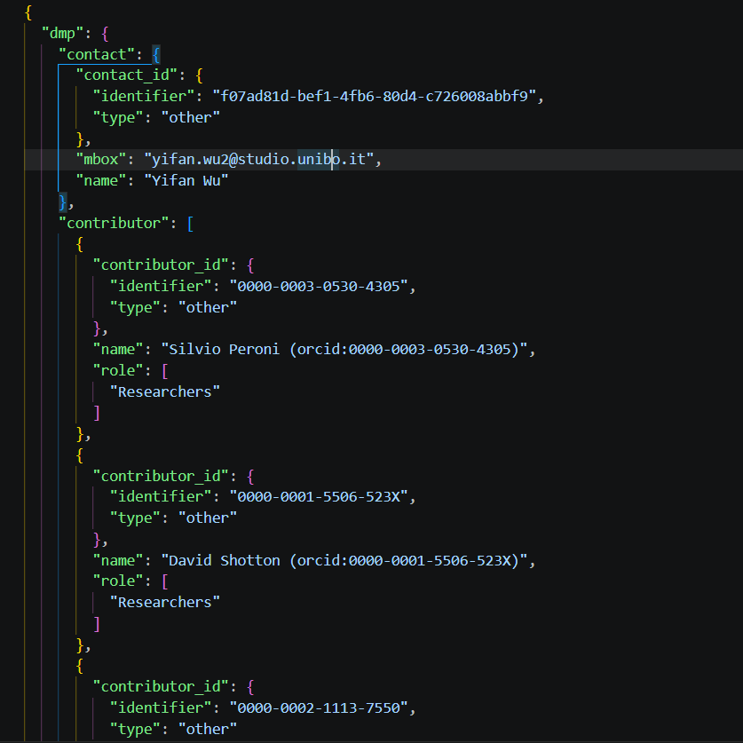
OPEN SCIENCE · OPENCITATIONS · DATA MANAGEMENT PLAN
DMP Extracted JSON
After completing the Plan and six Descriptions in Argos, I exported the DMP in JSON format. The export reorganizes the information according to the DMP schema. Each resource is then described.
Practical issues encountered
1 · Fragmented structure and confusing order
Related information is scattered across different objects and arrays
2 · Very difficult to read directly
The Json file is very difficult to read.
3 · Empty JSON objects appear in the export
Some arrays contain empty objects such as {} with no keys or values.
4 · Some text contains HTML markup
Certain text fields include HTML elements such as <div>...</div>
5 · Contributors are repeated
Contributors from different parts of the DMP are collected into one top-level contributor list. The same person can appear several times with different roles and in different ways
6 · The JSON preserves only part of the full Argos structure
The export does not reproduce every information writte in the DMP
OpenCitations_Data_Management_Plan.json

Slide 10
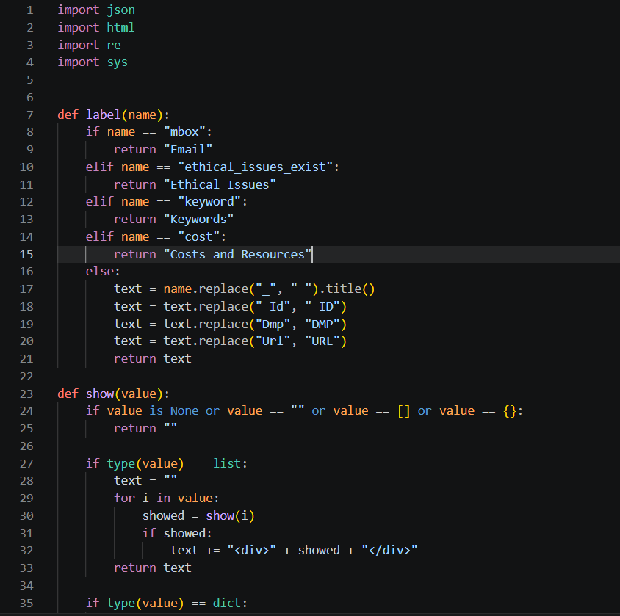
OPEN SCIENCE · OPENCITATIONS · DATA MANAGEMENT PLAN
Translator.py
Since the JSON is difficult to read directly, a Python script is required to reorganize the data into a clearer HTML to make it more human-readable.
Development logic
1. Import basic libraries: json, html, re, sys
2. Read the JSON file and extract data["dmp"]
3. Use label() to make JSON keys more readable, for example “xbox -> Email”
4. Use show() to convert values into HTML
5. Use make_html() to build the full page structure
6. Use main() to connect input JSON and output HTML
Translator.py

Slide 11
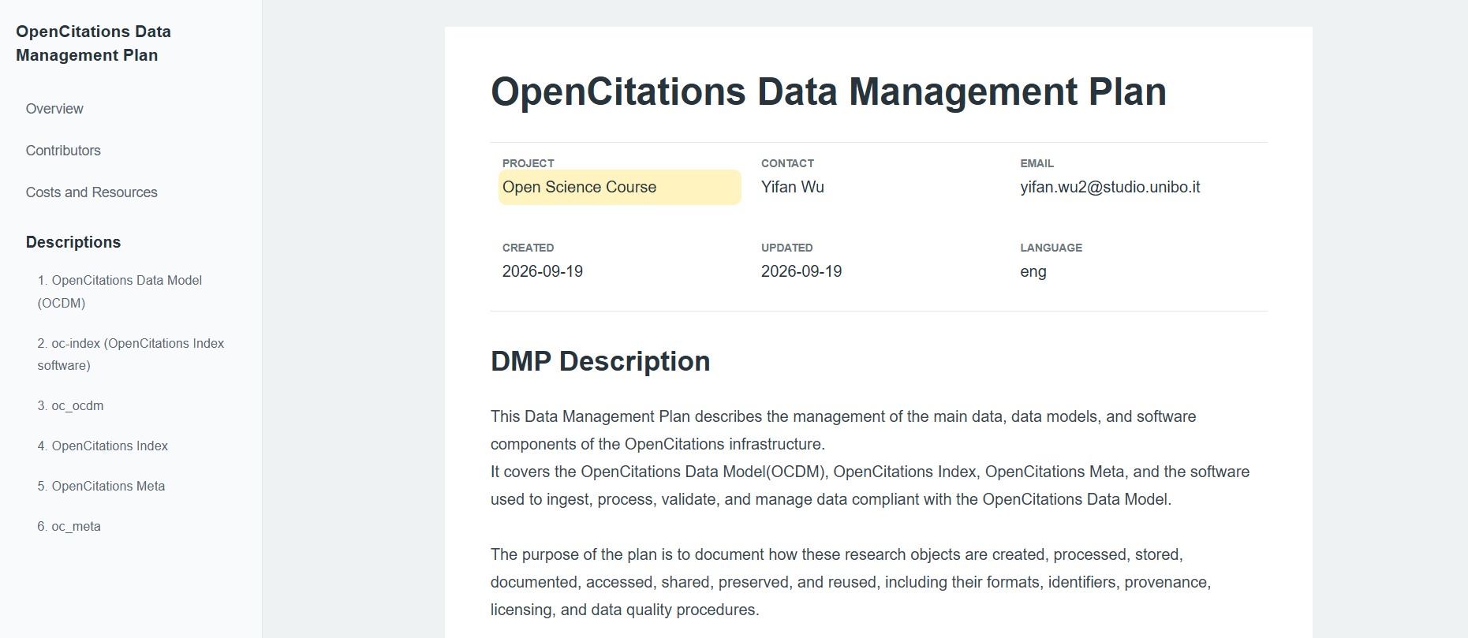
OPEN SCIENCE · OPENCITATIONS · DATA MANAGEMENT PLAN
Final HTML
A shared semantic model for scholarly entities, citations, identifiers, and provenance.
OpenCitations_Data_Management_Plan.html

Slide 12
Thank you
Questions
Yifan Wu · Open Science · a.y. 2025/2026
Notes:
约 20 秒。感谢听众并进入提问。The landscape footer comes from the reusable OCDM slide master.

